Slide 1

Analyzing Sales Data for Amazon Branches
This project aims to gain insight into the sales data of Amazon to understand the different factors that affect sales across its branches. Analyzing sales data helps measure sales strategies' effectiveness, identify trends, and make informed business decisions.

Slide 2

INTRODUCTION
This project aims to gain insight into the sales data of Amazon to understand the different factors that affect sales across its branches. Analyzing sales data helps measure sales strategies' effectiveness, identify trends, and make informed business decisions.
The dataset contains sales transactions from three different branches of Amazon, located in Mandalay, Yangon, and Naypyitaw. It includes various attributes such as invoice ID, branch, city, customer type, gender, product line, and more.
Data Overview
The dataset consists of 1000 rows and 17 columns, including numerical and categorical variables.

Slide 3

Analysis Overview
Product Analysis
Customer Analysis
Dive deep into the different product lines offered by Amazon and analyze their performance, popularity, and revenue generation.
Examine the customer demographics, purchasing behaviors, and preferences to gain insights that can inform targeted marketing strategies.
Sales Analysis
Scrutinize the sales data across the various branches to identify trends, patterns, and factors that influence overall revenue and profitability.

Slide 4
Distinct Cities and Branches
Distinct Cities
Branches and Cities
To find the count of distinct cities in the dataset, we can run the following SQL query:
To see the corresponding city for each branch, we can run this query:
select count(distinct City) as count_of_cities from amazondata;
select distinct branch, City from table from amazondata;
This will show us the unique combinations of branch and city in the dataset.
This will give us the total number of distinct cities represented in the data.

Slide 5
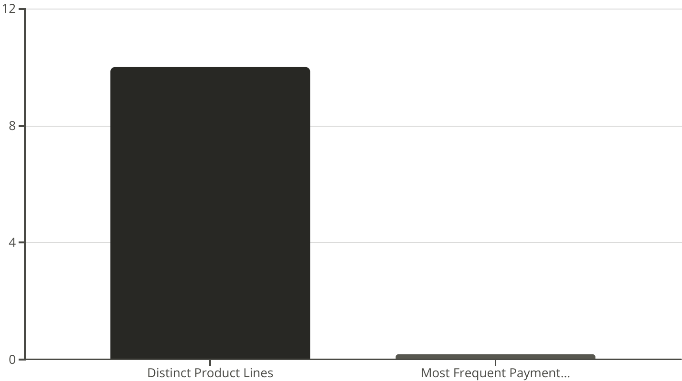
Distinct Product Lines and Payment Methods
The dataset contains 10 distinct product lines offered by Amazon. The most frequently used payment method is credit card.

Slide 6
Top Selling and Revenue Generating Product Lines
To determine which product line has the highest sales, we can run the following SQL query:
select Product_line, from amazondata
group by product_line
order by sales desc
limit 1;
This will give us the product line with the highest total sales.
To find the product line that generated the highest revenue, we can use this query:
select product_line, sum(total) as total_revenue from amazondata
group by product_line
order by total_revenue desc
limit 1;
This will return the product line with the highest total revenue across all sales transactions.

Slide 7

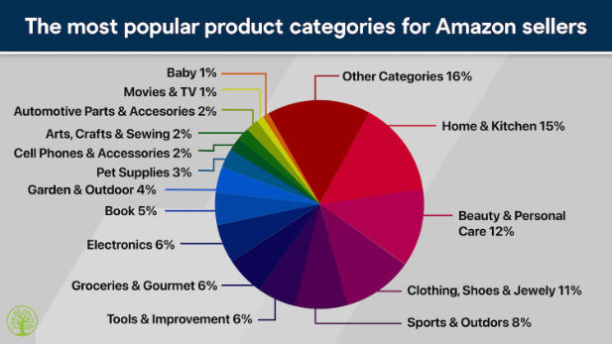
Highest Revenue City and Average Product Ratings
Highest Revenue City
To determine the city with the highest recorded revenue, we can run the following SQL query:
select city, sum(total) as revenue from amazondata
group by city
order by revenue desc
limit 1;
This query will return the city with the highest total revenue across all sales transactions.
Average Product Ratings
To calculate the average rating for each product line, we can use this query:
select product_line, avg(rating) as average_rating from amazondata
group by product_line;
This will provide the average customer rating for each distinct product line offered by Amazon.

Slide 8
Highest Revenue Customer Type
To identify the customer type contributing the highest revenue, we can run the following SQL query:
select customer_type, sum(total) as revenue
from amazondata
group by customer_type
order by revenue desc
limit 1;
This query will return the customer type that has generated the highest total revenue across all sales transactions.
Highest Purchase Frequency Customer Type
2773
Member
Purchase Frequency
Customer Type
To identify the customer type with the highest purchase frequency, we can run the following SQL query:
select customer_type, sum(quantity) as pur_frequency
from amazondata
group by customer_type
order by pur_frequency desc
limit 1;

Slide 9

Identifying Peak Engagement Times
Morning Hours
Customers provide the highest average ratings during the morning hours, indicating this may be a prime time for sales and customer engagement.
Evening Resurgence
Ratings rebound in the evening, highlighting the importance of maintaining a strong
1
2
3
Afternoon Dip
The analysis shows a dip in average ratings during the afternoon, suggesting an opportunity to optimize sales and marketing efforts during this time.

Slide 10
Uncovering the Best-Rated Days
Highest-Rated Day
Weekday Opportunities
Actionable Insights
According to the data, the day of the week with the highest average ratings is Sunday, indicating customers may be more engaged and satisfied with their purchases on weekends.
While Sundays shine, the analysis also reveals opportunities to improve ratings on weekdays, potentially through targeted marketing, product optimization, or customer service initiatives.
These findings can help Amazon tailor its operations, marketing, and customer experience strategies to align with the preferences and behaviour of its customer base.
Conclusion
This analysis of Amazon's sales data showcases the profound impact that data-driven insights can have on business strategy and performance. By leveraging the power of SQL, Amazon can uncover valuable customer behavior patterns, optimize operations, and deliver exceptional customer experiences – ultimately driving sustainable growth and maintaining its industry leadership.

